Slide 1
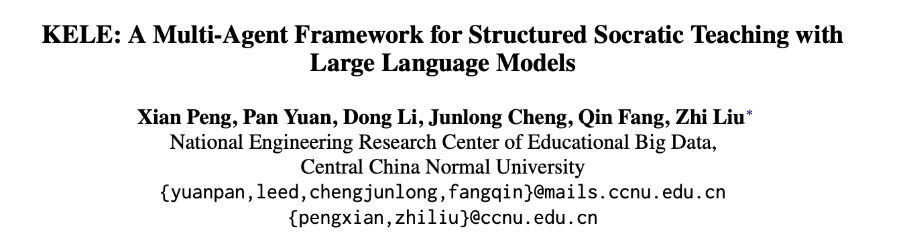
KELE: A Multi-Agent Framework for Structured Socratic Teaching with Large Language Models
Peng, Yuan, Li, Cheng, Fang, Liu - Central China Normal University
CSEN 346: Natural Language Processing
04/07/2026
Team: Cyberdyne

Slide 2


Team Members
Ulises Chavarria
Maximilian Khan

Slide 3
Problem & Motivation
CSEN 346: Natural Language Processing
Human tutors use guided questioning, but that kind of Socratic teaching is hard to scale.
KELE stood out because it uses role-specific agents, which connects naturally to Mixture of Experts ideas where specialized models can handle different teaching roles or subjects.
This is still an active research area, making it a strong foundation for our project.
Socratic teaching is powerful, but does not scale.
Heuristic questioning prompts deep thinking and cognitive development, but demands high teacher expertise and real-time adaptability (which is infeasible in large educational settings).
Existing LLM approaches fail in two ways:
Prompt engineering (e..g. SPL/GPT-4): mimics Socratic style but has no structured pedagogy, which leads to arbitrary guidance, abrupt topic shifts, disorganized feedback.
Fine-tuning (e.g. EduChat, SocraticLM): learns to withhold answers but lacks coherent teaching progression or summarization/reflection mechanisms.
The identified gap: No prior work combines structured teaching rules with LLM-based execution. Style mimicry without pedagogical structure is counterproductive - EduChat scores 90.73% on not giving answers, but only 2.93/5 on actually guiding the student.
KELE's thesis: Structure + specialization beats raw scale. A 9B model with the right framework outperforms GPT-4o.

Slide 4
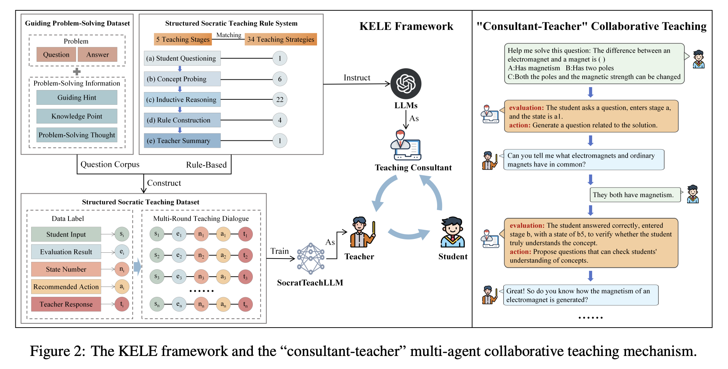
The KELE Framework: SocRule + Consultant-Teach Architecture
CSEN 346: Natural Language Processing
Consultant (Planner): Analyzes student cognitive state and dialogue history, which then outputs an evaluation to lookup a recommended teaching action
Teacher (Executor): Receives history and the consultant plan, which then generates a heuristic response
Per-turn flow: Given a student input that flows into the consultant classification system, the teacher generates a response given a SocRule lookup result.

Slide 5
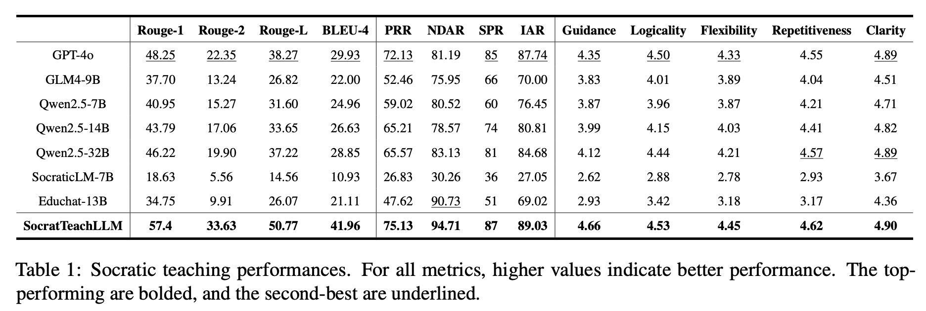
Results: 9B Models Beats GPT-4o on All 13 Metrics
CSEN 346: Natural Language Processing
Stated by authors:
1. Domain specificity: Socrat Dataset covers only elementary science. No cross-domain or cross-lingual evaluation. Performance on math, humanities, or programming is unknown.
2. Imperfect rule compliance: PRR of 75.13 means ~25% of turns still have relevance issues. The consultant-teacher mechanism mitigates but doesn't solve this.
KELE outperforms GPT-4o across all 13 evaluated teaching metrics, despite using a smaller 9B model.
The strongest gains come from better guidance quality, relevance, and teaching coherence, not just withholding direct answers.
This suggests that teaching methodology matters as much as, or more than, raw model scale in tutoring tasks.

Slide 6
Future Improvements and Our Project Direction
CSEN 346: Natural Language Processing
1
Mixture of Experts for Multi-Subject Teaching (gating)
2
RL-Based Stage Transitions (replace rigid rules)
3
Learned Consultant (via discrete classifier replacing LLM)
4
Stronger Evaluation (via ablation study and cross-domain)

Slide 7
Company Name
Project roadmap
CSEN 346: Natural Language Processing
Goal
Deliver a working reproduction-plus-improvement project that shows whether structured multi-agent tutoring can be made more adaptive, scalable, and robust.
Step 5
Evaluate the baseline against our improved version, analyze the tradeoffs, and prepare the final report and demo.
Step 4
Implement our improvement, such as learned stage transitions or a more scalable consultant module.
Step 3
Run baseline tests, inspect failure cases, and choose one extension to focus on for the rest of the project.
Step 2
Build a simplified KELE pipeline with consultant, SocRule stage selection, and teacher response generation
Step 1
Read the paper closely, identify the core components we must reproduce, and divide implementation responsibilities across the team.

Slide 8
Thank you

